Slide 1
Why Change Matters Utilizing change management to maximize the ROI of health information technology
Replace this text box with a logo
UPDATED OCTOBER 9, 2012
Presented by
Insert Name

Slide 2
Purpose of this deck
As part of an expressed need by the membership of the Pan Canadian Change Management Network, to clearly articulate and promote the value of change management to senior leaders within eHealth projects, the following slides have been developed to accompany the 1-paged document entitled, “Why Change Matters”.
Together these two items, along with a listing of further resources, are provided to support you in your efforts to make a business case for change by sharing evidence not only of the immediate business and financial impacts, but also of how effective change management strategies can help to ensure eHealth implementations deliver value for patients, providers and the health system.

Slide 3
The Value of Change Management
“Change Management, done well, done badly, or not done at all, will have a lasting impact on the sustainability of an organization.”
Les Harrison, CEO, Yellowknife Health and Social Services Authority, GNWT
Notes:
-In the world of eHealth, change management has can have lasting impacts on all elements of organizational performance, including quality outcomes, project delivery, risk management and financial health.

Slide 4
Unique industry, unique challenges
eHealth presents unique CM challenges:
Complex healthcare delivery structures
Organizational change resistance and fatigue
Emerging technologies
Health industry regulations
Strong, disparate professional cultures
Successful health IT implementations dedicate between 10-15%¹ and upwards of 30% of project budget towards CM activities.²
¹ Petouhoff, N., Chandler, T., Montag-Schultz, B. (2006). The business impact of change management: What is the common denominator for high project ROI's? Graziadio School of Business and Management, Pepperdine University. [Electronic document]
² Laflamme, F., Pletraszek, W., Rajadhyax, N. (2010). Reforming hospitals with IT investments. Mckinsey on Business Technology. Number 20, Summer 2010: 27-33.
Notes:
References:
Petouhoff, N., Chandler, T., Montag-Schultz, B. (2006). The business impact of change management: What is the common denominator for high project ROI's? Graziadio School of Business and Management, Pepperdine University. [Electronic document]. Accessed at: http://gbr.pepperdine.edu/2010/08/the-business-impact-of-change-management/ (November 2010).
Laflamme, F., Pletraszek, W., Rajadhyax, N. (2010). Reforming hospitals with IT investments. Mckinsey on Business Technology. Number 20, Summer 2010: 27-33. Accessed at http://www.ortechsystems.com/pdfs/MRreformingHospitalsITinvestment.pdf (May 11, 2012).

Slide 5
A Look at the Numbers
ROI of good change management
Effective CM strategies support average 143% ROI vs. 35% ROI with poor/non-existent CM.¹
With execution of CM activities:²
Consequences of poor change management
Cross industry studies suggest that with poor or non-existent CM:
95% of projects achieve IT management objectives
23% average over run on schedule; and
7% do not achieve scope/ functionality.”³
“70% of health IT projects fail or do not provide end-user satisfaction.”⁴
96% of projects achieve project management objectives
18% average over run on budgets;
“84% of projects do not hit their targets;
¹ Laclair, J., Pao, R. (2002). Helping employees embrace change. Managing change is the responsibility of everyone in the corporation—from senior managers on down. McKinsey Quarterly. November 2002 (4), 17 – 20.
² Coplan, S. Redefining health IT project success, Journal of Healthcare Information Management (HIMSS), Spring 2012, vol. 26, no 2.
³ Sauer, C., Cuthbertson, C. (2003). The State of IT Project Management in the UK 2002-2003. University of Oxford, England.
⁴ Anderson M. Six levels of healthcare IT.Davidson PL ed. Healthcare Information Systems, Auerbach Publications, Boca Raton (2000), pp. 97–108
Notes:
References:
Laclair, J., Pao, R. (2002). Helping employees embrace change. Managing change is the responsibility of everyone in the corporation—from senior managers on down. McKinsey Quarterly. November 2002 (4), 17 – 20.
Coplan, S. Redefining health IT project success, Journal of Healthcare Information Management (HIMSS), Spring 2012, vol. 26, no 2. Accessed at http://www.coplan.com/wp-content/uploads/2012/04/JHIM-Article.pdf (May 11, 2012).
Sauer, C., Cuthbertson, C. (2003). The State of IT Project Management in the UK 2002-2003. University of Oxford, England.
Anderson M. Six levels of healthcare IT.Davidson PL ed. Healthcare Information Systems, Auerbach Publications, Boca Raton (2000), pp. 97–108

Slide 6
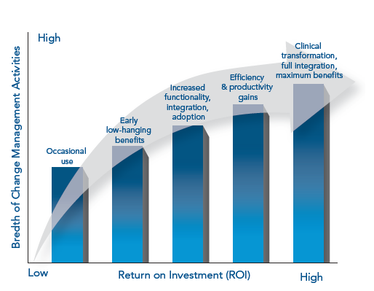
Change Management enables Realization of Benefits
Notes:
This graph demonstrates the relationship between the breadth of change management activities and the capture of benefits and overall return on investment (ROI) of a project.
Focused and appropriately resourced change management is a driver of adoption and for achieving benefits linked to organizational performance, staff engagement and morale, as well as delivery of value to patients, providers and the health system alike.

Slide 7
Are you effectively leading change?
Consider these questions:
What is your organization’s approach to change management?
Do you have a formal CM process in place across your organization?
Is CM facilitated at an enterprise or program level, or project by project?
What leadership supports are in place to support effective CM?
How have you communicated this internally?
How do you measure and report on change?
What indicators do you use to track progress?
How do you measure, analyze and mitigate risk?
Has CM been profiled within your organization as an expectation?
Is there evidence of CM on your organizational chart?
How have you structured your team to support these beliefs?
How do you embed these findings into ongoing reporting and communications?
Do you visibly demonstrate support for transformational change initiatives?
How do you deal with stakeholder resistance?
Notes:
These questions can help leaders determine whether they have the required processes and resources in place for effective change to take place.
For example, when considering your organization’s change management approach, consider:
Do you have a formal change management process in place across the organization?
Is CM facilitated at an enterprise or program level, or project by project?
Has CM been profiled within your organization as an expectation?
Is there evidence of CM on your organizational chart?
When considering the leadership supports required for effective CM, you may want to ask yourself:
How have you communicated this internally?
How have you structured your team to support these beliefs?
Measuring and reporting on change is also a crucial element of success. Consider the following:
What indicators do you use to track progress?
How do you measure, analyze and mitigate risk?
How do you embed these findings into ongoing reporting and communication?

Slide 8
What can you do as a leader?
Governance & Leadership | Establish a clear, concise vision for the change initiative Create time-bound, measureable, specific goals to evaluate success Conduct a realistic evaluation of the internal climate to improve focus of leaders and team efforts on key challenges Improve visibility and focus for executive/sponsor support Increase accountability for change initiatives Improve and expedite the decision-making process
Stakeholder Engagement | Provide a means to communicate and validate issues and barriers and ensure proactive management of these items
Communications | Provide stakeholders with timely information and allow for interaction with change leadership and project team Engage in open & honest conversations
Training & Education | Equip stakeholders with the necessary training, information about new processes, technologies, and skills required in order to achieve success post-change
Monitoring & Evaluation | Evaluate the success of the change initiative against vision and goals Continually monitor performance Reinforce change messaging with stakeholders
Notes:
Reference for leadership actions:
Department of Health & Human Services (HHS) Office of the National Coordinator for Health Information Technology (ONC) Change Management:
Strategies and Resources for the State HIE Program. 2010. Accessed at http://statehieresources.org/wp-content/uploads/2010/12/Change_Management.pdf (October 19 2012).

Slide 9
You can’t have a successful project without organizational CM. It is as important as good project management. All of the elements of CM including training, communications are an integral part of a major initiative. You can’t implement without it. You will manage the change or the change will manage you.
Roger Girard
Chief Information Officer, Manitoba eHealth

Slide 10
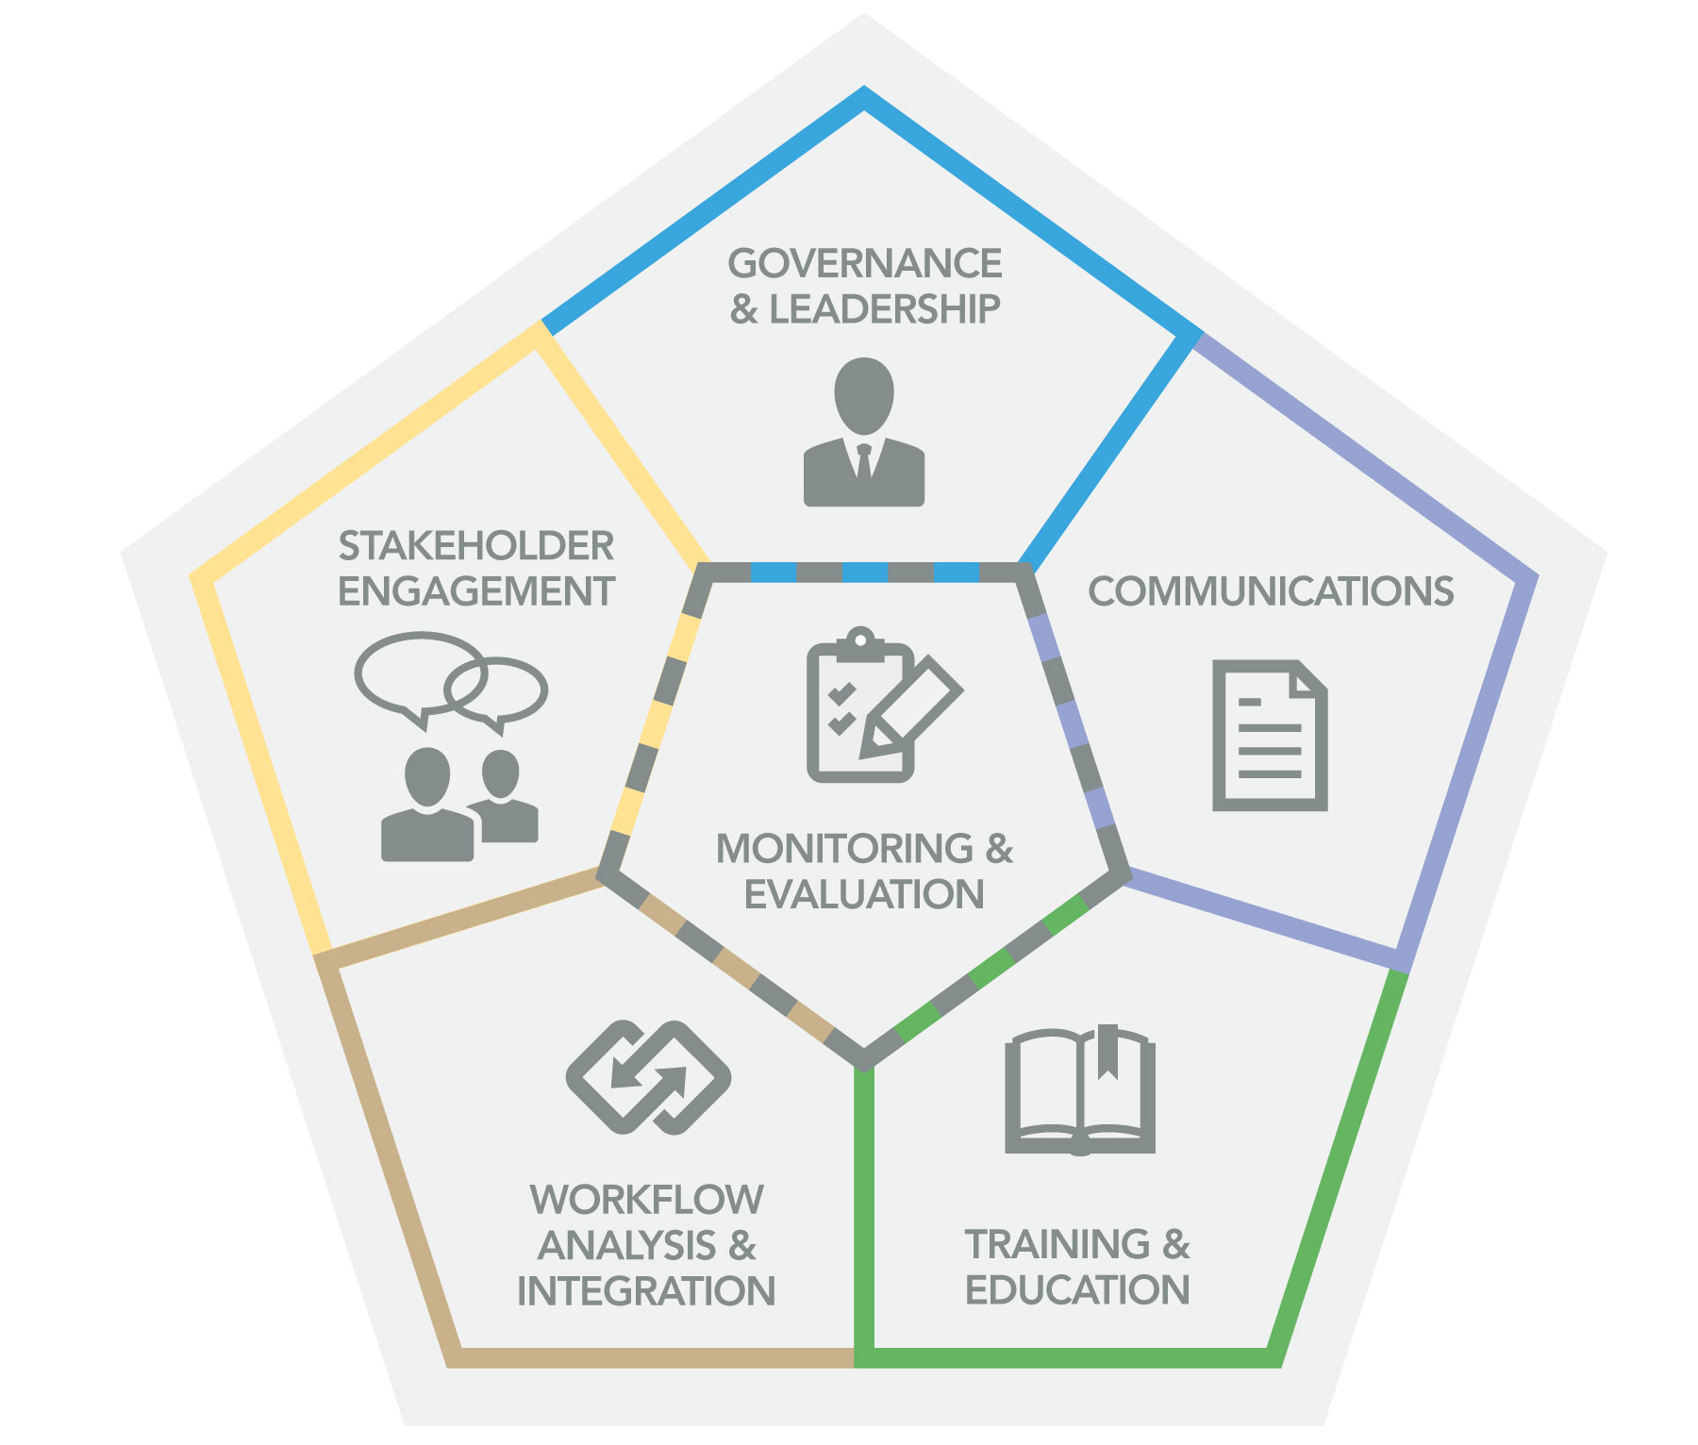
What is required?
Effective governance & leadership investment
Comprehensive stakeholder engagement
Workflow analysis & integration
Consistent communications
Training & education
Ongoing monitoring & evaluation
https://www.infoway-inforoute.ca/index.php/progress-in-canada/managing-change
Notes:
The National Change Management Framework, developed by the Pan-Canadian Change Management Network gives an overview of the required elements of an effective change management program.
More information about the framework, as well as helpful tools and resources related to each of the framework elements, are available on the Canada Health Infoway website.

Slide 11
Thank you
Replace this text box with a logo
11

